Slide 1

Super Charged Stations
Presented by:
Jimmy, Zack, Akanksha and Mariam

Slide 2
Introduction
Welcome to the world of EV and Project Introduction
Why we choose this project
Data sources
1. supercharge.inf (Json file)
2. kaggle.com (Csv file)

Slide 3
Data cleanup and Transformation
Json – world wide charging station dat
& Csv from Kaggle – Brand, Range, Model, Price etc.
We cleaned this data and filter USA data only
Created Database using Mongo DB
In Json file we have world wide data of Electric cars
We filtered USA data only
We used Jupyter notebook and establish connection with MongoDB
Used plotly for graphical representations of data within jupyter notebook.

Slide 4
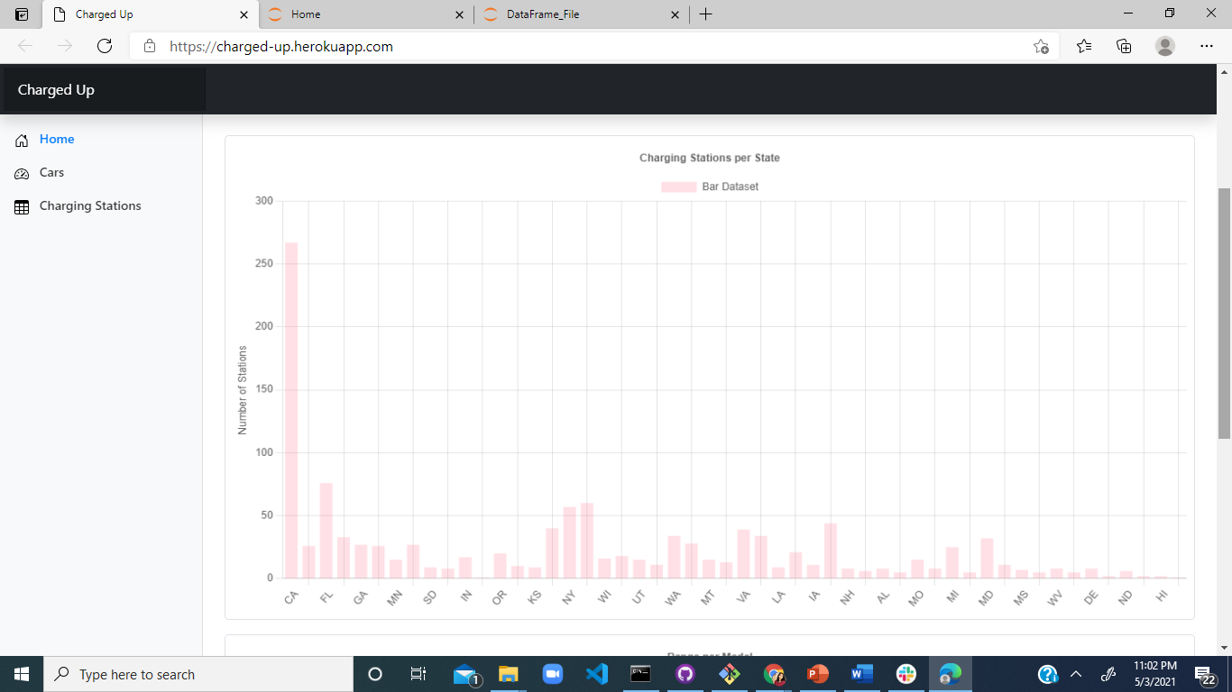

Slide 5
Above graph
In the above graph states with the most charging stations.
Example CA has most charging stations with 267.

Slide 6
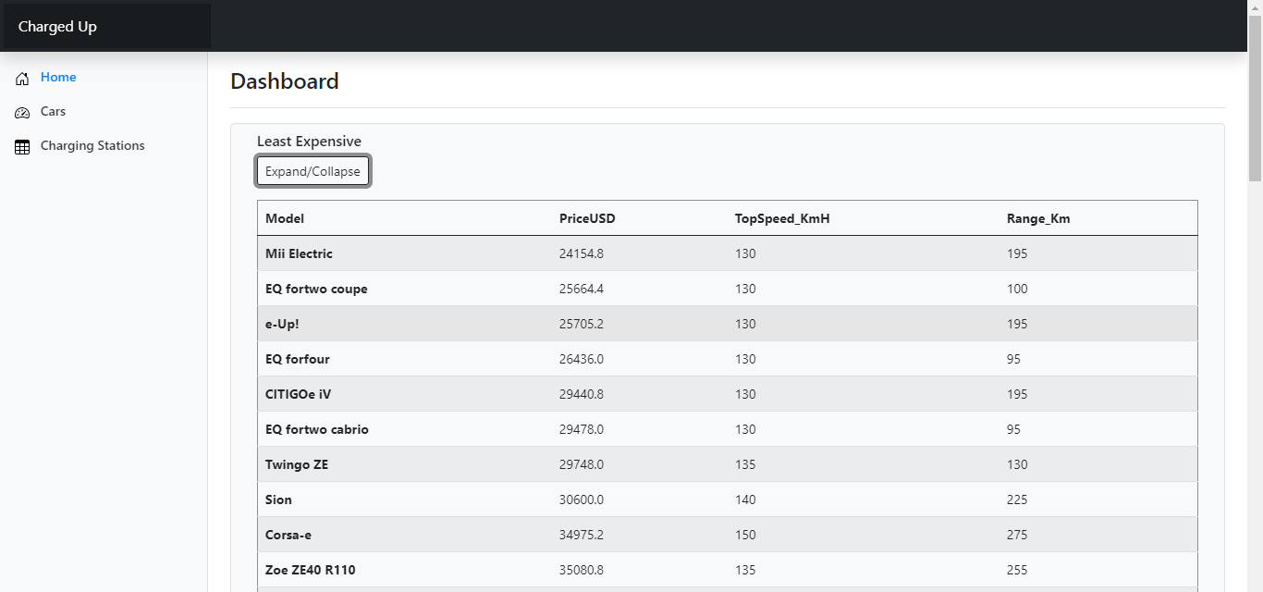

Slide 7
Above Table
Above table shows least expensive electric car.
Example : Mii Electric $24154.

Slide 8
Creating Dashboard and Deploy at Heroku
Create Html pages
Dashboard
Deploy at Heroku
Challenges

Slide 9
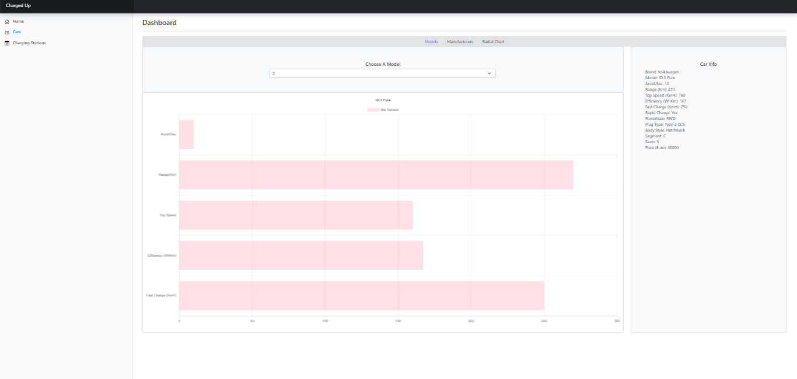

Slide 10
Above Graph
Car Info
Brand: Volkswagen
Model: ID.3 Pure
Accel/Sec: 10
Range (Km): 270
Top Speed (KmH): 160
Efficiency (WhKm): 167
Fast Charge (KmH): 250
Rapid Charge: Yes
Powertrain: RWD
Plug Type: Type 2 CCS
Body Style: Hatchback
Segment: C
Seats: 5
Price (Euro): 30000

Slide 11
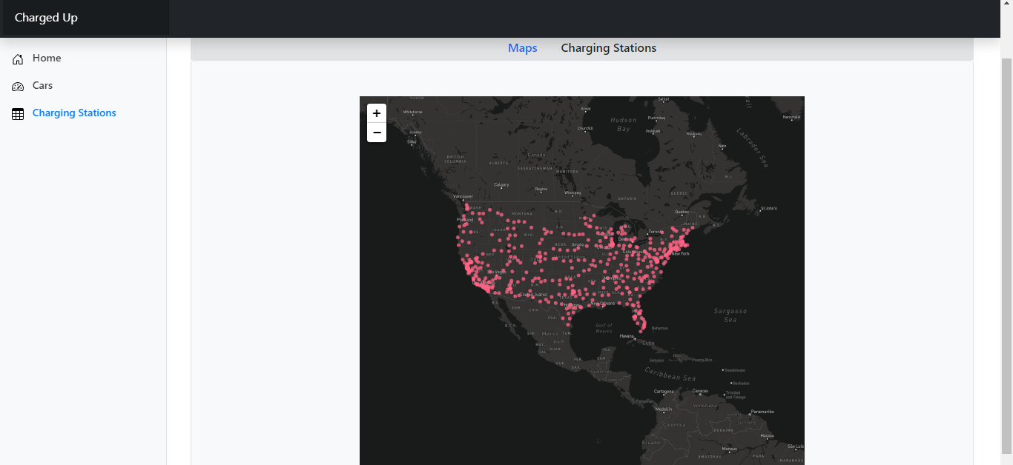

Slide 12
Above Graph
Above graph shows the charging station around the United States.

Slide 13
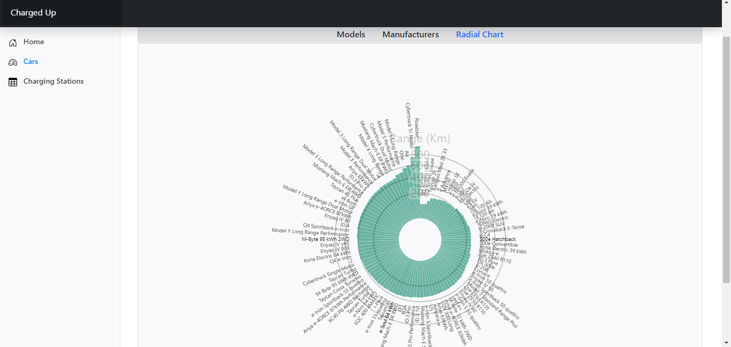

Slide 14
Project Summary
In this dynamic new shift the world is taking owning an Electric Vehicle will be the new norm
Electric cars can be powered naturally with renewable resources like solar, wind, and water power.
Electric vehicle will be the future of car making. And this concludes this presentation.

Slide 15
Thank You

